Slide 1
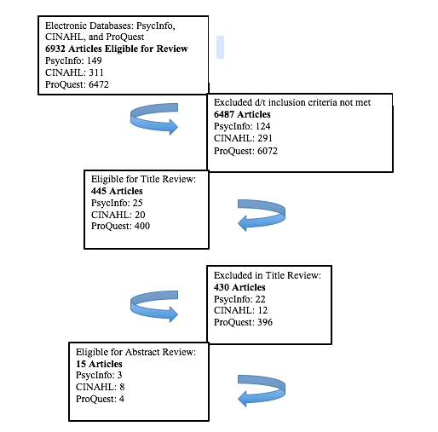
Factors Preventing Pregnant Teens from Early and Adequate Prenatal Care: Integrative Literature Review
Clare Keffer
Research Advisor: Dr. Young-Me Lee, PhD, RN
DePaul University School of Nursing
Background
Conceptual Framework
Results
Pregnant teens and their infants are exceptionally vulnerable to adverse birth outcomes. The most reliable way to reduce the incidence of these negative outcomes is to receive early and adequate prenatal care. There are a number of factors that prevent pregnant teens from receiving or even seeking prenatal care, including limited access, a lack of social support, and stigmas or biases held by cultures or even health care providers.
With the Maternal Role Attainment Theory, Ramona Mercer identified the three main systems that influence maternal role attainment:
Microsystem: the mother’s innermost system, consisting of familial relationships, intimate relationships, socioeconomic status, and values
Mesosystem: factors within the mother’s community, such as school, work, or child care
Macrosystem: encompasses social and cultural norms or influences that may impact the mesosystem or microsystem
Mercer’s Maternal Role Attainment Theory was selected to explore the connection between prenatal care and pregnant teenagers, especially to learn how parts of a pregnant teen’s systems can be factors preventing them from early and adequate prenatal care. These three main systems can also be useful in the development and implementation of intervention programs.
Among the 15 articles reviewed, the four major factors found that prevent teens from early and adequate prenatal care were identified as:
inconvenience
structure of care not being tailored to adolescents
lack of social support
unpreparedness/lack of motivation to become a mother
Objective
Research Limitations
Method
The purpose of this integrative literature review is to explore factors preventing pregnant teenagers from receiving early and adequate prenatal care, and the consequences they may encounter without receiving prenatal care. Additionally, this integrative literature review seeks to explore how to overcome said barriers and improve birth outcomes by examining what programs and interventions have been successfully implemented to address these factors.
The major limitations of this research include:
several of the studies had relatively small sample sizes
some were limited in regard to a lack of diversity in the population sampled
several programs took place in alternative educational settings and did not include traditional school programs.
An integrative literature review was compiled by using three databases: PsycInfo, CINAHL Complete, and ProQuest Nursing & Allied Health Source.
Search terms:
The keywords used were “prenatal care AND teen*” to find literature addressing the research question, which asks what factors contribute to pregnant teenagers not receiving early and adequate prenatal care.
Conclusion
Inclusion criteria used during this search:
A population of individuals that were pregnant teenagers or teenage mothers
Identification of factors preventing this population from receiving early and adequate prenatal care
Identification of intervention programs to provide prenatal care for pregnant teens
Modifications made to regular prenatal care programs to include better care for pregnant teens
Published between the years 2007 and 2017
Research Questions
This integrative literature review identifies inconvenience, a lack of prenatal care services tailored to adolescents, lack of social support, and unpreparedness to become a mother as the major barriers to receiving adequate prenatal care by pregnant adolescents, although further research is necessary to understand how to effectively and practically address these barriers and to evaluate the outcomes of intervention programs.
What are the factors that prevent pregnant teenagers from early and adequate prenatal care?
What are the current intervention programs addressing these factors?

