Slide 1
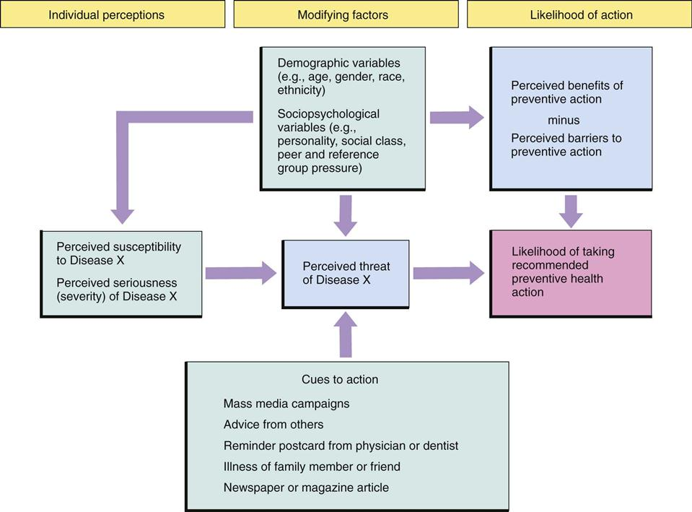
Barriers to Cervical Cancer Screening
Among Hispanic Women
Lauren Wils
Research Advisors: Dr. Linda Graf, DNP, RN & Young-Me Lee, PhD, RN
DePaul University
BACKGROUND
MATERIALS AND METHODS
RESULTS
Prior to the mid-twentieth century, cervical cancer was one of the most common causes of cancer death for American women
Rates have decreased by 50% over the last 40 years due to the development of the Papanicolaou (Pap) smear and HPV vaccine
American Cancer Society (ACS) estimates 13,240 new cases of invasive cervical cancer and 4,170 deaths by the end of 2018
In 2016, the World Health Organization (WHO) reported 79 million Americans were infected with HPV
The U.S. Preventative Task Force (UPSTF) recommends a Pap smear for ages 21-29 every 3 years and for ages 30-65 either screening every 3 years with cervical cytology alone or every 5 years with high risk testing alone (hrHPV)
Despite improvements, Hispanic women suffer higher rates of prevalence than any other minority group at 9.4 women per 100,000 cases
Integrative Literature Review
An integrative literature review was used to provide a comprehensive overview of literature on the psychosocial and sociocultural barriers to Hispanic women receiving cervical caner screening and successful intervention strategies. This analytical method focuses on a widespread picture of non-experimental and experimental research, offering a broad perspective.
Literature Search Strategies
Peer-reviewed searches were conducted using CINAHL, PubMed, PsycINFO and public health resources such as CDC, WHO, USPSTF, NCI and ACS.
Key words
Hispanics, Latinos, cervical, cervix, cancer, test*, screening, pap smear, psychosocial, sociocultural, cultural, barriers, perceptions, beliefs, intervention and adherence.
Inclusion Criteria
Cervical cancer screening, Pap smear and/or HPV testing
Specific psychosocial and/or sociocultural barriers and their influence on cervical cancer screening adherence
Hispanic women
Studies conducted in the United States
Published between 2007 and 2018
Intervention programs designed for Hispanic women
Intervention programs targeting psychosocial and/or sociocultural barriers
Final Selection
25 articles were then chosen for further review and analysis: 7 successful intervention strategies and 18 studies addressing specific social and cultural contexts within the Hispanic population.
Psychosocial and Sociocultural Barriers
Stigma of sexual promiscuity and religiosity
Purity, chastity
Diagnosis of cervical cancer is considered a punishment from God
Fear/embarrassment
Feelings of peña—shyness, modesty, embarrassment
Fear of pain during exam, potential diagnosis, stereotyping
Mistrust of providers
Higher rates of negativity about providers, discrimination
Familial/male influence
Parental relationship
Machismo– a patriarchal characteristic associated with males making healthcare decisions for family
Women fearing male partner’s jealousy
Suggestion of condom use and fear of domestic violence
Positive effects—proper education shows male interest in protecting female partner against HPV/cervical cancer
Interventions
Community outreach
Public service announcements, newsletters, bilingual contact representatives
Positive social network
The Witness Project—cancer survivors as educators
Machismo—male involvement in education
Mix-media
Radionovelas, photonovelas, kiosks
Social media—YouTube, Facebook, Twitter
Television programs
CINHAL, PsycINFO & Pubmed:
371 articles
Initial search criteria with key words
In-depth sociocultural and psychosocial barriers and intervention programs in cervical cancer screening among U.S. Hispanic women
25 articles used:
7 intervention programs/18 studies
Applied additional criteria: Journal Articles/Peer-reviewed, from 2007-2018
176 articles selected
Discussion
PURPOSE
Cervical cancer is highly preventable, yet Hispanic women hold the highest rates of poor screening due to not only economic health disparities but also cultural and social barriers
Suggestions for Future Research
Interventions should focus on molding negative barriers into positives—utilize machismo to promote peer-education
Incorporate culturally tailored interventions—offer faith-based programs at churches
Examine differences in barriers based on country of origin
Limitations
Excluding articles on other cancers (breast or colon etc.) and other minority groups may have provided additional insight
Implications for Nursing
Cultural competence and thorough assessment of barriers
There have been limited studies identifying in-depth factors that contribute to attitude, perception and personal beliefs about the importance of cervical cancer screening among Hispanic women
The purpose of this integrative literature review is to investigate the psychosocial and sociocultural barriers to cervical cancer screening among the Hispanic population
What are the psychosocial and sociocultural barriers that limit the preventative care of cervical cancer such as Pap smears and HPV testing among Hispanic women?
What intervention strategies exist to increase adherence to cervical cancer screenings for Hispanics that focus on overcoming specific psychosocial and/or sociocultural barriers?
Health Beliefs Model
Search Process and Results
Conceptual Framework
The Health Beliefs Model is selected to provide an understanding of psychosocial and sociocultural barriers to cervical cancer screening among Hispanic women. The Health Belief Model (HBM) is a psychological model that attempts to explain and predict certain health behaviors. The attitudes and beliefs of the individual are highlighted, and then used as predictors that the individual will take a health-related action.. The model has been successfully applied in areas such as sexual risk behaviors and the transmission of HIV/AIDs, as well as breast and cervical cancer prevention strategies. The HBM has also been specifically used to assess why Hispanic women did not attend mammograms or Pap smear appointments and attempts to understand intervention strategies that can be utilized to change the behavior about attending appointments.
Concluson
Additional research is needed into specific intervention strategies

