Slide 1
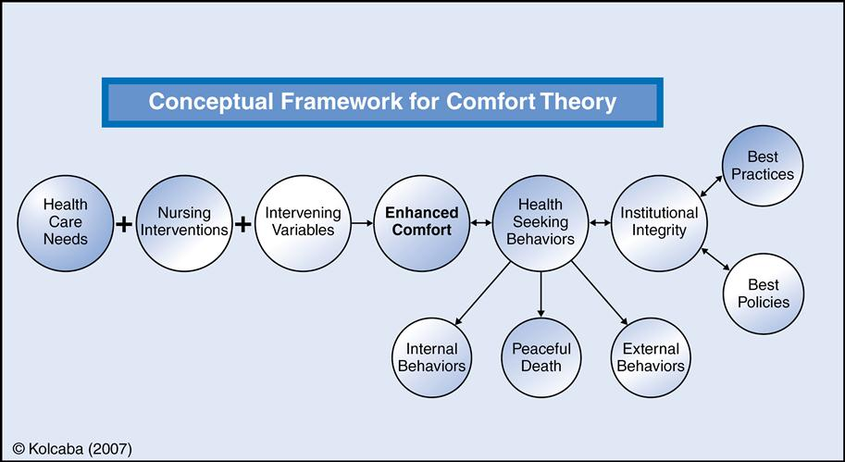
Effects of Alternative Headache Treatments
In Adolescents:
An Integrative Literature Review
Joanna Youstra
Research Advisor: Lauren Rossen MSN, RN
DePaul University School of Nursing
BACKGROUND
CONCEPTUAL FRAMEWORK
RESULTS CONTINUED
Headache pain effects all aspects of a child’s life from school, to activities of daily living to the basic quality of life.
The most common referral to neurology departments for children is for headaches, particularly migraine headaches
Adolescents have been shown to be the most prevalent pediatric population reporting headache pain. The pain is most often managed through pharmacological therapy.
With approaches to integrate CAM with pharmacological therapies, providers may be able help alleviate pain in a holistic “mind-body” approach. The number of adolescents who are using CAM could be increased if they were aware of the options.
Influencing Factors
Age
Socioeconomics and Health Insurance
Co-occurring Chronic Conditions
Kolcaba determined that comfort is the result of holistic nursing
Comfort exists in 3 forms:
Relief
Ease
Transcendence
When a patient is able to transcend above the challenge, for example pain, they are able to accomplish comfort.
LIMITATIONS
Duration, intensity and amount of time experiencing pain was not analyzed.
Participants surveyed did not report if they were using pharmacological methods in conjunction with CAM.
Studies were done by parent report.
METHODS
An integrative literature review was used.
Databased used: CINAHL (Cumulative Index for Nursing and Health Literature), PubMed, Up to Date and ProQuest
Keywords used: pediatric, children, headache, complimentary, alternative, treatments, holistic, adolescent, medicine, pain management, evidence-based practice, therapy, and migraine
NURSING IMPLICATIONS
TRIFOLD AREA – THIS GUIDE WILL BE REMOVED BEFORE PRINTING – TRIFOLD AREA – THIS GUIDE WILL BE REMOVED BEFORE PRINTING – TRIFOLD AREA – THIS GUIDE WILL BE REMOVED BEFORE PRINTING – TRIFOLD AREA – THIS GUIDE WILL BE REMOVED BEFORE PRINTING – TRIFOLD
TRIFOLD AREA – THIS GUIDE WILL BE REMOVED BEFORE PRINTING – TRIFOLD AREA – THIS GUIDE WILL BE REMOVED BEFORE PRINTING – TRIFOLD AREA – THIS GUIDE WILL BE REMOVED BEFORE PRINTING – TRIFOLD AREA – THIS GUIDE WILL BE REMOVED BEFORE PRINTING – TRIFOLD
The information in this literature review can be used by nurses to help their patients ease pain in a holistic way.
With more information available regarding what CAM methods are the most beneficial, nurses may feel more comfortable advising patients on CAM therapy.
Nurses equipped with information on CAM therapy have the power to better the quality of adolescent’s life when experiencing headache pain.
PURPOSE
The purpose of this integrative literature review was to explore literature for studies to identify the modalities of CAM that have demonstrated efficiency on decreasing headache pain and influencing factors contributing to the use of CAM for headache in adolescents aged 13-18.
RESULTS
CAM Modalities Most Commonly Used
Biologically based therapies
*Herbal and nonvitamin supplements,
*Vitamin supplements
*Special diets
Manipulative or body-based therapies
*Chiropractic/osteopathic manipulation
*Massage
*Craniosacral/exercise therapy
*Tai chi/ Qi Gong
Mind-Body Therapies
*Meditation
*Yoga
*Biofeedback
*Hypnosis
*Guided imagery
*Progressive relaxation
*Cognitive behavioral therapy
CONCLUSION
RESEARCH QUESTIONS
The results can give valuable information to health care providers to refer patients for alternative or adjunct therapy in treating headache pain in adolescents.
Some research has been done on the use of CAM for adolescents with headache pain. This integrative literature review more fully defined the modalities most commonly used and the factors influencing their use.
1. What modalities of CAM have the highest efficacy for decreasing headache pain in the adolescent population in the United States?
2. What influencing factors contribute to the use of CAM for headache pain in adolescents?
…

