Slide 1
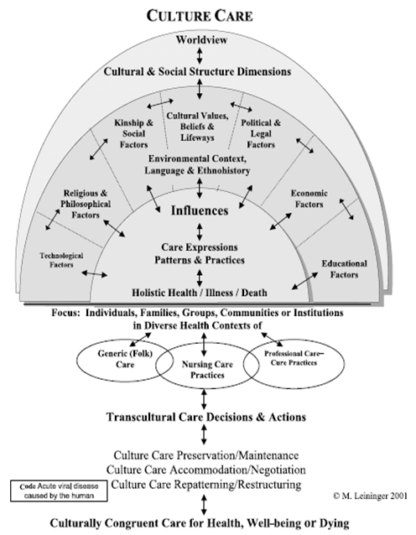
Barriers and Mental Health of Undocumented Latinos in the United States Maricela Rodriguez
Research Advisor: Dr. Elizabeth Aquino DePaul University School of Nursing
Introduction
Methods
Discussion
Mental disorders rank among the greatest causes of death worldwide
Mental illness affects 1/5 adults in the U.S. each year
Undocumented Latinos are greatly affected by mental illness
There are about 11.4 million undocumented immigrants in the U.S.; half being Latino
Regardless of status, Latinos face many difficulties, but having an undocumented status magnifies such challenges
The undocumented status creates external barriers, such as economic stress and lack of employment, which manifests in exclusion, discrimination and isolation
The external barriers are progressively internalized, and begin creating psychological barriers that can ultimately affect mental health and daily living
CINAHL
Found:
53
Met Inclusion Criteria
10
PubMed
Found:
34
Met Inclusion Criteria:
8
Academic Search Complete
PsychInfo
Found:
31
Met Inclusion Criteria:
12
Found:
134
Met Inclusion Criteria:
20
Excluding Duplicates:
8
Used in Review:
2
Used in Review:
1
Excluding Duplicates:
4
Used in Review:
4
Excluding Duplicates:
11
Used in Review:
3
Excluding Duplicates:
10
When undocumented Latinos face barriers such as poor educational opportunities, inadequate economic possibilities and weak social integration, they are more likely to be unsuccessful in their new community
Barriers faced by undocumented Latinos can lead to poor mental health and well-being
It is important to address the barriers and mental health issues that undocumented Latinos face in a culturally sensitive manner
Integrative literature review
Databases Searched
CIINAHL
PubMed
PsycINFO
Academic Search Complete
Inclusion Criteria
Research published between 2013 and 2018
Available in English
Exclusion Criteria
Studies conducted outside the U.S.
Studies that looked at legal Latinos
Studies that focused on non-Latinos
Results
Barriers faced by undocumented Latinos
Educational opportunities:
Many participants reported lack of educational opportunity due to lack of financial assistance
Economic possibilities
Undocumented Latinos are often forced to take low-paying, high-risk jobs
Women in abusive relationships reported not being able to leave their abuser due to financial dependence
Social Integration
In order to avoid disclosing an undocumented status, many Latinos reported not being able to integrate
Policies, such as not being able to get a driver’s license often prevent undocumented Latinos from integrating
Mental health consequences
Fear
Fear of deportation was reported by many participants. Fear prevented many Latinos from going to hospitals, or police stations when necessary
Isolation/loneliness
Due to an undocumented status, and fear of deportation, many Latinos reported feeling isolated from school, work, health services and people
Depression
Frustrations of not being able to find steady work or attend school, along with other limitations undocumented Latinos face, exacerbate their feelings of depression
Conclusion
TRIFOLD AREA – THIS GUIDE WILL BE REMOVED BEFORE PRINTING – TRIFOLD AREA – THIS GUIDE WILL BE REMOVED BEFORE PRINTING – TRIFOLD AREA – THIS GUIDE WILL BE REMOVED BEFORE PRINTING – TRIFOLD AREA – THIS GUIDE WILL BE REMOVED BEFORE PRINTING – TRIFOLD
TRIFOLD AREA – THIS GUIDE WILL BE REMOVED BEFORE PRINTING – TRIFOLD AREA – THIS GUIDE WILL BE REMOVED BEFORE PRINTING – TRIFOLD AREA – THIS GUIDE WILL BE REMOVED BEFORE PRINTING – TRIFOLD AREA – THIS GUIDE WILL BE REMOVED BEFORE PRINTING – TRIFOLD
Nursing
Undocumented Latinos face many challenges, which can be amplified by their undocumented status, ultimately affecting mental health
Latinos face the following barriers: poor educational opportunities, inadequate economic possibilities and weak social integration
Due to their undocumented status, Latinos face mental health consequences: fear, isolation/loneliness and depression
This vulnerable population could benefit from interventions that reduce the barriers they experience
Providing resources to support their mental health problems would decrease mental health disparities
Purpose
The purpose of this integrative literature review is to identify barriers that undocumented Latinos in the United States face and to describe what the overall mental health consequences of having an undocumented status are
Nursing Framework: Leiniger’s Culture Care Sunrise Model
In order to provide culturally congruent and holistic care, theory emphasizes the need to consider all aspects of each person’s life
Undocumented Latinos have their own unique culture, in order to improve their mental health we must take the time to understand it
Research Questions
Future Research
What are the barriers that undocumented Latinos face in the U.S.?
What are the mental health consequences of being an undocumented Latino living in the U.S.?
The protection of undocumented Latinos’ identities must be better implemented so that more research can be completed
The development of interventions that reduce the barriers faced by this population and promote mental health should be explored

