Slide 1
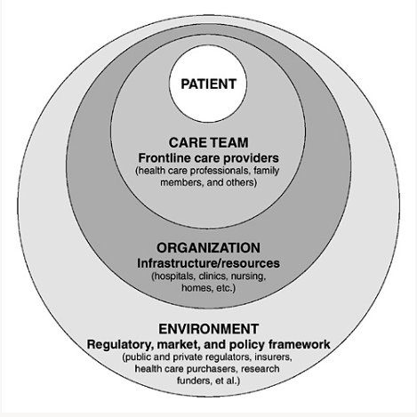
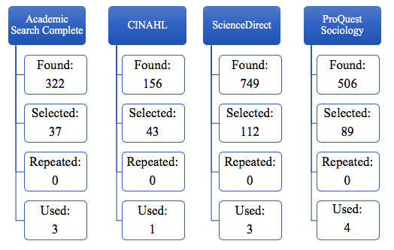
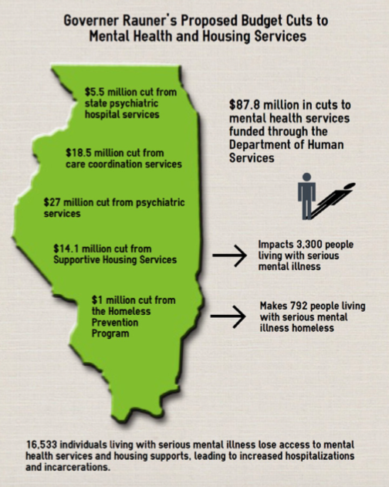
Barriers to Providing Psychiatric Care Within Cook County Public Health System: An Integrative Literature Review
Elizabeth Ann Reuter
Research Advisor: Dr. Sierra Bushe
DePaul University
Background
Method
Conceptual Framework
Cook County Public Health System located in Cook County, Illinois, is responsible for providing free and low cost psychiatric care to thousands of residents despite continuing state and federal budget cuts and inadequate Medicaid reimbursements
This not only financially strains county taxpayers, but it also limits treatment options, negatively impacts patients, and places an extreme burden on the public service workforce
An integrative literature review was conducted using the databases of Academic Search Complete, CINAHL, ScienceDirect, and ProQuest Sociological
Ferlie and Shortell’s Multi-Level Change Framework was selected to describe the multi-level change necessary for implementation of successful improvements in large health care systems
Inclusion criteria used during this search:
A population of individuals that currently receives or has ever received psychiatric care from Cook County Public Health Systems
Published between 2005 and 2018
Barriers to providing mental health care
Identification of barriers to providing care within Cook County Public Health Systems
Purpose
Search terms included: Cook County, public health, services, health systems, mental illness, psychiatric care, mental health care, Illinois, Chicago, statistics, issues, factors, health data, interventions, prevention, health care facilities, resources, costs, and behavioral health
The purpose of this literature review is to identify the barriers of providing psychiatric care within Cook County Public Health Systems
The findings of this study will allow further research to be conducted in order to bring awareness to barriers of providing psychiatric care to Cook County residents
Figure 1. Multi-Level Change Framework
Future Research
Findings
This design provides a platform for further research as well as a foundation for social awareness; with more specific research it could also provide useful information as an implication for future change in health policy
Further studies outlining specific strategies to reduce the barriers faced by many different patient populations served by Cook County Public Health Systems would also provide useful information to assist in future change
Among the eleven articles reviewed, four major barriers were identified:
Lack of funding
Throughout the literature, lack of funding was highlighted as the most significant barrier to providing psychiatric care in Cook County
Ongoing state and federal budget cuts, inadequate Medicaid reimbursements, and high costs of lengthy and intensive psychiatric services all contribute to lack of funding
(2) Staff shortages in the public service workforce
Frequent and recurrent utilization of emergency care services involving persons with mental illness burdens mental health care workers, first responders, social workers, correctional officers and police officers
This contributes to burnout for an already strained public service workforce and further increases staff shortages in the field
(3) Criminalization of mental illness
Chronic homelessness, illegal substance abuse, and misunderstood behavior during acute psychotic episodes contribute to frequent and reoccurring police arrests in individuals with mental illness
Incarceration precipitated by mental illness, unsuccessful re-entry into society related to incongruencies in public health care, and the subsequent re-incarceration becomes a cycle that is difficult to break for many individuals
(4) Psychosocial aspects of mental illness
Individuals with chronic mental illnesses like schizophrenia, bipolar disorder, and severe major depression can experience disabling psychosocial effects that interfere with employment, interpersonal relationships, educational options and overall health status
Conclusion
This study examines the existing barriers to providing psychiatric care, with emphasis placed on lack of funding as the most significant barrier
More research is necessary to further understand how each specific barrier affects not only the ability to provide care, but also how each barrier affects the population of Cook County residents receiving care
Research Question
What are the barriers to providing psychiatric care within Cook County Public Health System?

