Slide 1
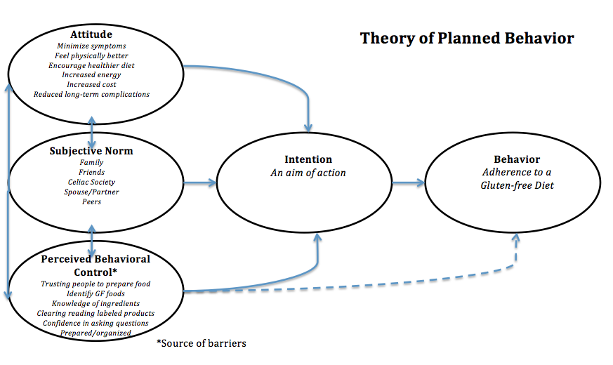
Barriers of Dietary Adherence in Children with Celiac Disease
Kiley Janas MSN
DePaul University School of Nursing
Background
Conceptual Framework
Results
Nursing Implications
Celiac disease is a chronic autoimmune disorder defined by permanent sensitivity intolerance to gluten, the protein found in wheat, rye and barley
Adherence to a gluten-free diet is the only treatment option available for those with the celiac disease
Barriers to dietary compliance have been studied among adults, but limited attempts have been made in exploring barriers of dietary adherence in children, as well as strategies to overcome the barriers
4 Barriers to Dietary Adherence
Poor availability: Not having access to gluten-free options is associated with low adherence rates
Insufficient labeling: Experiencing difficulties in detecting gluten from food labels is linked with non-adherence to a gluten-free diet
Lack of knowledge: Misunderstandings about celiac disease and the gluten-free diet is related to dietary non-adherence by children with celiac disease
High cost: The overall financial impact on the expense of gluten-free foods is associated with non-adherence.
3 Strategies to Dietary Adherence
Better awareness: Increased knowledge about celiac disease helps improve adjustment to the disease and increases dietary adherence
Improved labeling: Being able to identify gluten in products through efficient, clear labeling is essential to adherence to the gluten-free diet.
Societal support: Support of a celiac association is critical in improving adherence to a gluten-free diet.
The diagnosis of celiac disease is becoming more prevalent in the pediatric health care setting.
It is the responsibility of the nurse to educate parents and children on the implementation of a gluten-free diet and strategies to adherence.
Appropriate resources, support and information given by nurses will in turn increase the client’s devotion to treatment and with an anticipation to a better quality of life.
Methods
Research Design
An integrative literature review guided by the Whittemore and Knafl (2005) framework was used
Literature Search Stage
3 databases: PubMed, Cumulative Index of Nursing and Allied Health (CINAHL) Complete and ProQuest Nursing & Allied Health Source
Keywords: celiac disease, children, barriers, dietary adherence OR compliance, strategies and gluten-free diet
Data Evaluation & Data Analysis
Steps of data reduction, display and comparison revealed 6 articles addressing barriers and 5 articles identifying strategies to dietary adherence were analyzed
Conclusions
Purpose of Study
This review found four contributing barriers to dietary adherence and three strategies to dietary adherence including increased support through societal associations: however, there is a limited number of programs aimed at children.
Therefore, the expansion of societal support programs aimed specifically at children would be beneficial in supporting dietary adherence.
To identify the barriers of adherence to a gluten-free diet among children suffering from celiac disease
To explore effective strategies to increase adherence among the pediatric population in order to improve the quality of life in children living with celiac disease

