Slide 1
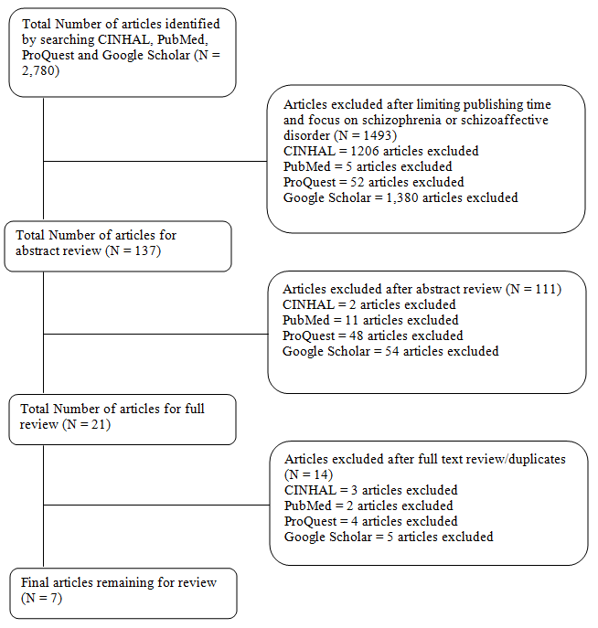
Effects of Animal Therapy in Adult Patients with Schizophrenia or Schizoaffective disorder
Evelyn Neville
Barbara Harris, RN, PhD, Research Advisor
DePaul University School of Nursing
Background
Methods
Results
Every year 1.1% of U.S. adults are diagnosed with schizophrenia (SCZD) every year, while 0.3% of is diagnosed with schizoaffective disorder (SCAD)
SCZD and SCAD hold severe symptoms that limit social interaction and effectively isolate these individuals from their communities
Positive symptoms include hallucinations, word salad and delusions while
Negative symptoms are a lack of energy, decreased expressiveness and apathy.
First line pharmacological treatment often only has measurable effects on positive symptoms
Animal Assisted Therapy (AAT) provides positive physical and psychological effects
For example: improved feelings of loneliness, increased socialization
Research Design
Integrative Literature Review of existing research
7 articles chosen including qualitative and quantitative studies
Literature Search Strategies
Databases searched include CINAHL (Cumulative Index for Nursing and Health Literature) complete, PubMed, UpToDate, ProQuest Nursing and Google Scholar.
Keywords used in isolated or combination searches include:
animal-assisted therapy, dog therapy, equestrian therapy, schizophrenia, and schizoaffective disorder.
Literature Search Inclusion and Exclusion Criteria (See Figure 2)
Inclusion Criteria:
Published within last 10 years (2008-2018) with emphasis on healthcare
At least 25% of participants have confirmed diagnosis of SCZD or SCAD
Adult Population of patients (18-65 years of age) for both inpatient and outpatient settings
Exclusion Criteria for studies:
Focus on pediatric/geriatric patients
Focus on other psychiatric disorders besides SCZD and SCAD
Not peer –reviewed or professionally translated into the English language
Findings for Research Question 2:
Six out of seven research articles supported AAT as being a worthwhile adjunct therapy to patients with SCZD and SCAD.
One article found no significant differences between control and research group.
General consensus that further research must be completed to confirm findings of their studies on a larger scale
Nursing Implications/Limitations
Limitations
small sample size of studies
diverse usage/implementation of animal assisted therapy
Nursing Implications
build rapport and therapeutic relationships
utilize experiences of therapy to engage in discussions
nurses should monitor interest and effectiveness of AAT adjunct therapy
Purpose/Research Question
Results
Purpose Statement
Gather current research on the use of animal-assisted therapy on patients with schizophrenia or schizoaffective disorder and examine the effects on patients.
Research Questions
1. What are the positive effects of animal assisted therapy on adults with schizophrenia or schizoaffective disorder?
2. Is animal assisted therapy in adults with schizophrenia or schizoaffective disorder an effective adjunct therapy?
Findings for Research Question 1:
Four major positive outcomes
Increased social contact/social functioning
Several studies found that patients with SCZD or SCAD who participated in AAT had increased social contact or social functioning during and outside of the supervised therapy time
Decreased negative symptoms
Patients participating in AAT were found to have a decrease in negative symptoms such as apathy, anhedonia and a sociality
Decreased anxiety/stress
A decrease in anxiety and/or stress provided a more healing environment and allows patients with SCZD or SCAD to focus on their treatment
Increase in self-esteem and increased adherence/motivation for treatment
Improvements on self esteem provide patients with SCZD and SCAD a way to improve their interactions with their community. Increased adherence and motivation for treatment is an important finding to improve outcomes for patients with SCZD and SCAD
Conclusion
Four major positive outcomes discovered for utilizing AAT on patients with SCZD or SCAD
Increased social interaction/social functioning
Decreased negative symptoms
Decreased anxiety/stress
Increase in self-esteem and increased adherence/motivation for treatment
Animal Assisted Therapy is a worthwhile adjunct therapy for patients with schizophrenia or schizoaffective disorder though further research on a larger scale must be completed to confirm these findings on a larger scale
Conceptual Framework
Figure 2. Literature Search and Results on AAT
Contact Information
Acknowledgements
Evelyn Neville
DePaul University School of Nursing
Email: evelynsneville@gmail.com
Young-Me Lee, RN, PhD

