Slide 1
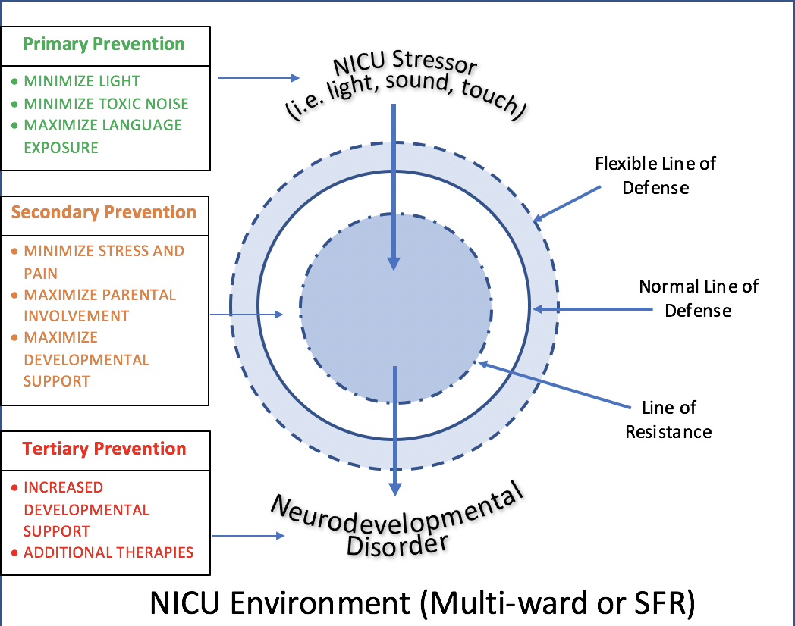
The Impact of Neonatal Intensive Care Unit Design on Neurodevelopmental Outcomes
of Premature Neonates: Single Rooms vs. Multi-bed Wards
An Integrated Literature Review
Tory Bugaieski, MS with Larry Maturin, MSN, APN, ACNS-BC, CEN, CCRN
DePaul University School of Nursing, Chicago, IL 60604
BACKGROUND
RESEARCH QUESTIONS
NURSING IMPLICATIONS
NICU admission occurs in 77.9 per 1000 live births^{1.} Medical expenses, maternal care, early intervention costs, special education, and lost productivity costs later in life yield an average lifetime expense of nearly $52,000².
Jerusalinkski³ notes that the immature brain of premature infants is ill-equipped to process and selectively inhibit environmental stimuli incurred in the NICU, a factor compounded by inability of infants to dictate their environment and remove themselves from stressful incidents⁴.
Consequently, premature infants are especially susceptible to environmental stressors, particularly in the NICU where they may encounter intense stimuli such as bright lights, loud noises, and abnormal tactile stimulation (including exposure to painful and invasive procedures, along with reduced skin-to-skin contact)^{4,5}
There is a growing expectation that single-family rooms (SFR) in the NICU will improve patient outcome by affording greater privacy, environmental control and space customization to the medical and developmental needs of each individual patient⁵.
While most studies report beneficial effects of the SFR in NICUs, very few studies focus on the neurodevelopmental outcome associated with specific NICU designs.
Neurodevelopment refers to cognitive, neurologic, and/or sensory development of the individual; negative neurodevelopment may manifest as cognitive delay, hearing deficit or loss, and visual impairment among other presentations⁶.
Does NICU patient room design (multi-bed wards versus single-family rooms) affect neurodevelopment in premature infants?
2. What interventions can nurses and other healthcare professionals take to attenuate environmental stressors and maximize neurodevelopmental outcomes in multi-bed and single-family room NICUs?
Primary Prevention
SFR and OPEN environments present similar visual developmental outcomes; SFR provides increased individual control but mechanisms associated with SFR control may not be necessary to provide optimum developmental care^{9, 11}.
Both SFR and OPEN environments require decreased auditory stimulation relating to volume (decibels) to conform to recommended neuroprotective levels^{12, 16}.
Both SFR and OPEN require increased exposure to meaningful language which may be facilitated through increased parental involvement, language exposure at proper volumes, elimination of arbitrary unit noise, increased nurse communication with infants (especially SFR), and reduced length of NICU stays^{14, 17, 18}.
Secondary Prevention
Minimize stress and pain through maximization of parental and maternal involvement in both settings (particularly OPEN^{)15.}
Frequent stress and pain assessments
Pharmacological and non-pharmacological measures
Determine appropriate level of developmental support and maternal involvement required for developmental level of individual infants in both settings¹⁵.
Tertiary Prevention
Increase availability and use of developmental support, particularly in the OPEN environment¹⁵. This includes use of additional physical, occupational, speech and other therapies.
Applies to preterm infants both during their stay in the NICU and after discharge from the NICU.
Figure 1. (Above). In the Neuman Systems theoretical model, the NICU environment presents excessive stressors that permeate a preterm infant’s defenses and resistance⁷. This results in reactive neurological alterations and may manifest in neurodevelopmental disorders. Environmental nursing interventions can act on the patient and environment to prevent, reduce, or minimize the effects of negative neurodevelopmental outcomes.
Figure 2. (Right). Gestational age and brain volume (From Kappelou et al.⁸ ).
RESULTS
ENVIRONMENTAL
Light intensities and day/night cycling similar in both SFR and OPEN environments, however light sources (fluorescent vs. natural) and regulation methods (blanket vs. room adjustment) differed⁹.
Sound levels were noticeably lower, more uniform and independent of peak staff activity in the SFR NICUs⁹; there was also significantly more silence over a 16h period¹⁰. OPEN NICUs allowed more exposure to sound and language but not necessarily within the appropriate range for developmental effects¹¹. Infants in both SFR and OPEN were exposed to little meaningful language but total language exposure did not differ between room types¹⁰.
SFR advantages included improved parental involvement and visitation^{11, 12, 13}; this includes breast/bottle feeding, kangaroo care, and parental bathing and diaper care¹³. SFR demonstrated an increased number of developmental support sessions and an overall increased degree of developmental support¹³.
NEURODEVELOPMENTAL
No differences were noted in Premie Neuro scores¹⁴ or head circumference at 30 weeks^{9, 13}, retinopathy of prematurity, nor prevalence of blindness, nor necessity of glasses of at 18-24months. One study reported no differences in hearing loss, while one reported increased prevalence of hearing aids in OPEN infants at 18-24months¹². SFR infants demonstrated fewer apnea events and fewer apnea events/day⁹. SFR infants demonstrated shorter intervals to maternal breast milk, mean TPN days, and TPN days/LOS⁹.
Infants in the SFR demonstrated better (lower) NNNS scores in attention, physiologic stress, hypertonicity, lethargy, and pain scores¹⁵. At 18-24 months corrected age, infants in the SFR NICU had higher Bayley-III fine motor scores¹²; cognitive composite and motor composite results varied with one study reported better outcomes for SFR infants¹², and another no difference in cognitive scores and decreased motor score for SFR¹⁴. SFR and maternal involvement individually mediate pain scores¹³.
Mixed results exist in regards to language exposure and developmental outcomes, particularly in SFR. One study reported lower language composite scores on the Bayley-III in SFR infants¹⁴, while another reported significantly higher composite and expressive scores¹². SFR infants demonstrated altered brain structure, including altered cerebral development, diminished normal hemispheric asymmetry and trending towards lower aEEG cerebral maturation scores. These occurred in brain areas associated with language development¹⁴. SFR infants presented with higher ITSEA scores in externalizing problems and decreased scores for social and emotional compliance¹⁴.
METHODOLOGY
CONCLUSIONS
An integrative literature review was used to analyze the neurodevelopmental outcomes in NICUs with multi-bed wards and single-family rooms. This analysis provided a basis of evidence to recommend nursing interventions that maximize neurodevelopmental outcome in both settings.
A total of 3 databases were used to procure relevant sources: PubMed, Cumulative Index to Nursing and Health Literature (CINAHL), and PsychInfo.. Multiple text combinations were utilized in all three databases and the following key words were used in searches: neonatal intensive care unit, environment, patients’ rooms, infant development, child development, brain.
The articles included in this review demonstrate that NICU patient room design (SFR vs. OPEN) does affect neurodevelopment in premature infants, however these environmental and developmental effects are not necessarily in line with initial hypotheses and results are mixed.
Multiple studies emphasized the need for further research to better understand the implications of environmental impacts within the OPEN and SFR settings. Particular points for clarification include language exposure and development, presence and mediation of stress and pain, and sleep patterns.
Abbreviations: OPEN, open-ward/multi-bed; SFR, single-family room ; MBM, maternal breast milk; TPN, total parenteral nutrition; LOS, length of stay; NNNS NICU Network Neurobehavioral Scale; aEEG, amplitude integrated electroencephalography.
REFERENCES
Please see attachment.
Notes:
References:
1. Harrison, W. & Goodman, D. (2015). Epidemiologic trends in neonatal intensive care, 2007-2012. JAMA Pediatrics, 169(9), 855-862.
2. Institute of Medicine. (2007). Preterm Birth: Causes, Consequences, and Prevention. Washington, D.C.: National Academy Press.
3. Da Fonseca Pinto, E., e Silva, I. L., Cardoso, F., & Beresford, H. (2008) The stress of the premature newborn: An axiologic reflection regarding possible influences of sensory-environmental factors in intensive care units for the newborn. Fitness & Performance Journal (Online Edition), 7(5), 345-351. doi:10.3900/fpj.7.5.345.e
4. Allen, A. M. (1995). Stressors to neonates in the neonatal unit. Midwives: Official Journal of the Royal College of Midwives, 108(1288), 139-140. Retrieved from https://www.rcm.org.uk
5. White, R. D. (2015). The sensory environment of the intensive care nursery. In R. J. Martin, A. A., Fanaroff, & M. C. Walsh (Eds.), Fanaroff and Martin’s neonatal-perinatal medicine: Diseases of the fetus and infant (10th ed.) (pp. 513-514). Philadelphia, PA: Elsevier Saunders.
White, R. D. (2003). Individual rooms in the NICU – an evolving concept. Journal of Perinatology, 23(Supplement 1), S22-S24.
6. Wilson-Costello, D. & Payne, A. (2017). Long-term neurodevelopmental outcome of preterm infants: Epidemiology and risk factors. In M. S. Kim (Ed.), UpToDate. Retrieved October 7, 2017 from https://www-uptodate-com.ezproxy.rosalindfranklin.edu/contents/long-term-neurodevelopmental-outcome-of-preterm-infants-epidemiology-and-risk-factors?source=history_widget
7. Neuman, B., & Fawcett, J. (2009). The Neuman systems model (5th ed.). Upper Saddle River, NJ: Prentice Hall.
8. Kapellou, O., Counsell, S. J., Kennea, N., Dyet, L., Saeed, N., Stark, J. . . . Edwards, A. D. (2006). Abnormal cortical development after premature birth shown by altered allometric scaling of brain growth. PLoS Medicine, 3(8), 1382-1390. doi: 10.1371/journal.pmed.0030265
9. Domanico, R., Davis, D. IK., Coleman, F., & Davis, B. O. (2011). Documenting the NICU design dilemma: Comparative patient progress in open-ward and single family room units. Journal of Perinatology, 31(4), 281-288. doi: 10.1038/jp.2010.120
10. Pineda, R., Durant, P., Mathur, A., Inder, T., Wallendorf, M., & Scblaggar, B. L. (2017). Auditory exposure in the neonatal intensive care unit: Room type and other predictors. The Journal of Pediatrics, 183, 56-66.e3. doi: 10.1016/j.jpeds.2016.12.072
11. Meredith, J. L., Jnah, A., & Newberry, D. (2017). The NICU environment: Infusing single-family room benefits into the open-bay setting. Neonatal Network, 36(2), 69-76. doi: 10.1891/0730-0832.36.2.69
12. Vohr, B. McGowan, E., McKinley, L., Tucker, R., Keszler, L., & Alksninis, B. (2017). Differential effects of the single-family room neonatal intensive care unit on 18-24-month Bayley scores of preterm infants. The Journal of Pediatrics, 185, 42-48. doi: 10.1016/j.jpeds.2017.01.056
13. Lester, B. M., Hawes, K., Abar, B., Sullivan, M., Miller, R., Bigsby, R., ... Padbury, J. F. (2014). Single-family room care and neurobehavioral and medical outcomes in preterm infants. Pediatrics, 134(4), 754-760. doi: 10.1542/peds.2013-4252
14. Pineda, R. G., Neil, J., Dierker, D., Smyser, C. D., Wallendor, M., Kidokoro, H., ... Inder, T. (2014). Alterations in brain structure and neurodevelopmental outcome in preterm infants hospitalized in different neonatal intensive care unit environments. The Journal of Pediatrics, 164(1), 52-60.e2. doi: 10.1016/j.jpeds.2013.08.047
15. Lester, B. M., Miller, R. J., Hawes, K., Salisbury, A., Bigsby, R., Sullivan, M. C., & Padbury, J. F. (2011). Infant neurobehavioral development. Seminars in Perinatology, 35(1), 8-19. doi: 10.1053/j.semperi.2010.10.003
16. American Academy of Pediatrics. (1997). Noise: A hazard for the fetus and newborn. Pediatrics, 100(4), 724-727. doi: 10.1542/peds.100.4.724
17. White, R. D., Smith, J. A., Shepley, M. M. (2013). Recommended standards for newborn ICU design, eighth edition. Journal of Perinatology, 33(S1), S2-S16. doi: 10.1038/jp.2013.10
18. Rand, K. & Lahav, A. (2014). Impact of the NICU environment on language deprivation in preterm infants. Acta Paediatrica, 103(3), 243-248. doi: 10.1111/apa/12481

