Slide 1
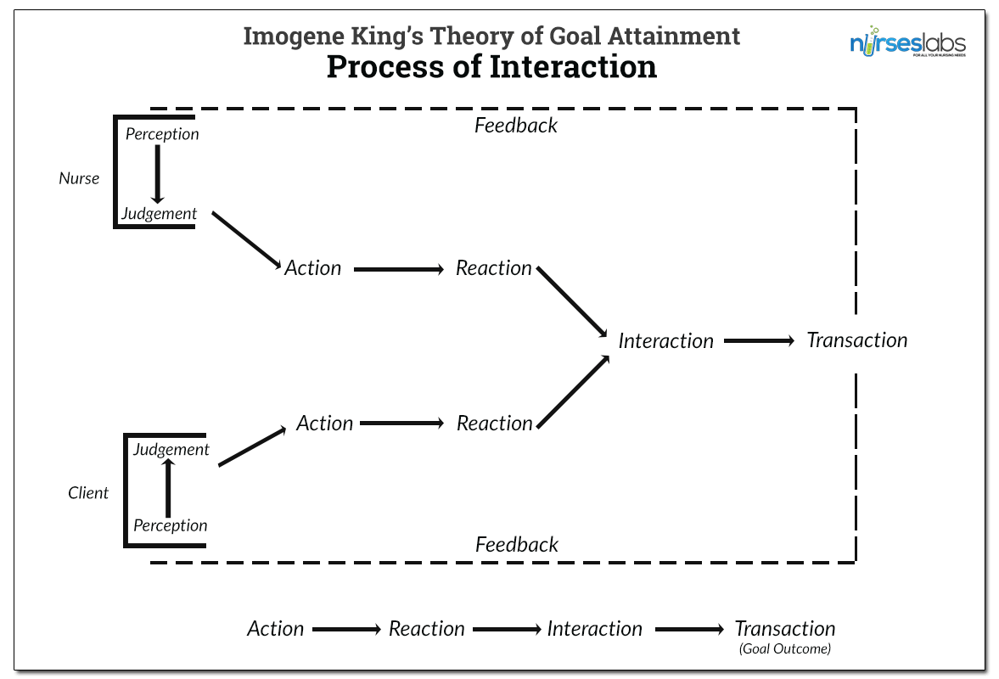
The Benefits of Complementary and Alternative Medicine For Treating Rheumatoid Arthritis: An Integrative Literature Review
Kali Polich, MS
DePaul University
Dr. Elizabeth Hartman, PhD, RN
BACKGROUND
RESEARCH QUESTIONS
CONCLUSIONS
Rheumatoid Arthritis is a “chronic, systemic autoimmune disease distinguished by joint swelling and tenderness and destruction of synovial joints, leading to disability and premature death” (McCance & Huether, 2014). It affects approximately 1% of the adult population in developed countries and its’ frequency increases with age. (McCance & Huether, 2014).
The most common manifestations of the disease are in line with other inflammatory responses; fever, fatigue, weakness, anorexia, weight loss, and generalized aching and stiffness. Joints will be swollen and painful. Morning stiffness is extremely common. Deformed fingers, toes, and limbs eventually result from the chronic synovitis. These issues can cause physical limitations from pain and muscle atrophy. Rheumatoid nodules are another complication. The nodules are characterized by their central tissue necrosis surrounded by a proliferating connective tissue. (McCance & Huether, 2014). Overall, Rheumatoid Arthritis causes issues across all bodily systems and daily functioning.
The purpose of this integrative
literature review was explore current
research on the methods of treatment
of Rheumatoid Arthritis and
demonstrate the benefits of
complementary modes of treatment.
Application of King’s Theory of Goal Attainment
What are the current beneficial pharmacologic treatment methods of Rheumatoid Arthritis?
What non-traditional methods of treatment have proven beneficial to treating Rheumatoid Arthritis?
The Whittemore and Knafl (2005) method of integrative literature review was used to systematize the literature found for this research.
The diverse methodology of an integrative review with both quantitative and qualitative studies worked to provide key examples of how complementary and alternative medicine (CAMs) is beneficial for the treatment of Rheumatoid Arthritis.
Databases utilized: CINAHL, PubMed
The treatment of Rheumatoid Arthritis has largely focused on the use of pharmacologic agents to manage the autoimmune inflammatory response. The use of complementary and alternative methods of management are less well known. The efficacy and benefits were identified to show the purpose of complementary and alternative medicine for treating Rheumatoid Arthritis.
Conclusive Results:
Yoga/Pilates: Decrease in disease activity, enhanced balance, decreased perception of pain, and decreased depression scores. Improvements in HAQ disability index and mobility of joints
Herbal Therapy: Marked reduction in pain
Comprehensive Occupational Therapy: Significant functional improvement but no effect on pain
Exercise: Pain reduction and functional improvement
Inconclusive Results:
Acupuncture
Therapeutic Ultrasound
Low-Level Laser Therapy
Thermotherapy
Transcutaneous Electrical Nerve Stimulation
METHODS
In conclusion, the biggest implication of this literary review is the need for more research to be performed in order to provide indisputable evidence that complementary and alternative methods of treatment provide marked benefits. Certain CAMs such as yoga/pilates, herbal therapy, exercise, and comprehensive occupational therapy provided significant evidence in the support of pain reduction and functional improvement. Other therapies were ambiguous in their results demonstrating the need for future research to be performed. Additional studies will help clarify the benefits and use of complementary and alternative medicine in treating Rheumatoid Arthritis.
The most important ramification of the increasing use of complementary and alternative methods of care for the treatment of Rheumatoid Arthritis is the need for nursing awareness and education on such methods of treatment. Nurses will be the ones responsible for coordinating CAMs with traditional medicine, understanding the potential risks/benefits, as well as discerning the efficacy and benefits of such treatments. Overall, the duties of the nurse will expand to encompass a more holistic approach to care.
PURPOSE
RESULTS
NURSING IMPLICATIONS
CONCEPTUAL FRAMEWORK
REFERENCES
Please See Attached Sheet

