Slide 1
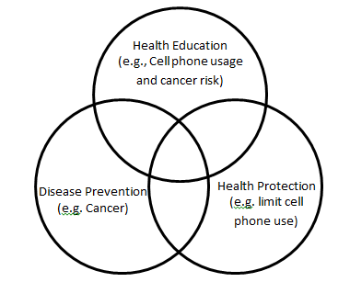
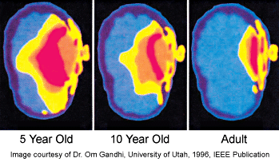
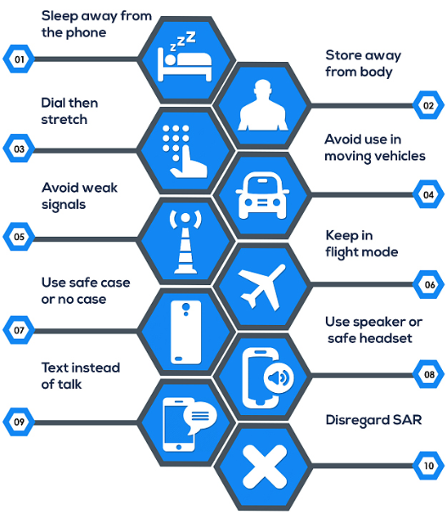
Sarah Lyn Orante Navarro, MSN
Kathleen Rylance, DNP, APN, CNP, RN
Cellular Phone Use and Possible Risk of Cancer in Children and Adolescents
Introduction
Purpose
Conclusion
More than 327.5 million people own cell phones as of December 2014 in the United States. With numbers sharply growing, time spent on phones also increases as these devices have been integrated in everyday living. When used, mobile devices emit radiofrequency electromagnetic fields (RF-EMF), which may raise a health risk related to carcinogenic effects. Concerns of prolonged use of wireless devices may be correlated to the development of cancer, especially in children and adolescents ages seven to eighteen years old.
The purpose of this integrated literature review is to explore the studies regarding children’s and adolescent’s use of cellular devices and risk of brain cancer development.
Conceptual Framework
The Tannahill Model focuses on three main ideas: health education, prevention, and health protection. It has been widely referenced in student’s undergraduate and postgraduate education to lay out interventions intended for medical and clinical purposes.
There is no conclusive evidence cellular devices poses a risk in the development of cancer. More studies are needed to explore the association between tumor growth and prolonged cell phone use. Longer latency periods of research are desirable to investigate possible carcinogenic effects.
Pathophysiology
Methodology
Research Type: Integrative Literature Review
Databases: CINAHL Complete (5 articles used), PubMed (2 articles used), and ProQuest Nursing and Allied health (1 article used)
Search terms included: cell phone and cancer
Limitations: Humans; English; Child birth to 18 years old
Cellular devices emit radiofrequency (RF) waves, which is a form of low-energy, non-ionizing radiation in the electromagnetic spectrum. Unlike ionizing radiation that can damage deoxyribose nucleic acid (DNA) in cells, non-ionizing radiation does not alter the charged electrons in particles; however, they are still able to move and vibrate atoms. If the body were to absorb a large amount of RF radiation in cellular tissues, it may induce adverse biological effects which may lead to the development of tumors. Based on a child’s anatomical structure of their head, children have more ion particles, thinner skulls, and have higher water content. These factors contribute to an increased risk of RF radiation exposure when putting the phone next to their ear, which is targeted near the brain. As a result tumors may form.
Results and Discussion
Eight studies have revealed there is no association between cellular phone use and adverse health risks. Regular mobile device users were not likely to develop cancer compared to nonusers. There are no clear trends on tumor volume growth with respect to increased cellular exposure. Cancer will not develop in children or adolescents despite the high amount of exposure. However, there are limitations in each study that has led to controversies of these results.
Nursing Implications
With inconclusive evidence of this study, we still must be cautious with the use of mobile phones. As nurses, patient education is crucial, especially with children and adolescents who constantly use cellular devices. Informing parents, teachers, and kids about the possible negative effects of radiofrequency technology that can be harmful to our body is crucial. As professional healthcare providers, we can teach alternatives in using cellular devices while reducing the exposure of radiofrequency.
Reference: Aydin, D., Feychting, M., Schuz J., Tynes, T., Andersen, T., Schmidt, L., .. . Roosli, M. (2011). Mobile phone use and brain tumors in children and adolescents: A multicenter case-control study. Journal of the National Center Institute, 103(16), 1267-1276.; Carlberg, M., Soderqvist, F., Mild, K. H., & Hardell, L. (2013). Meningioma patients diagnosed 2007-2009 and the association with use of mobile and cordless phones: A case-control study. Environmental Health: A Global Access Science Source, 12(1), 1-10.; Redmayne, M. (2013). New Zealand adolescents’ cellphone and cordless phone user-habits: are they at increased risk of brain tumours already? A cross-sectional study. Environmental Health: A Global Access Science Source, 12(1), 1-10.; Schuz, J., Jacobsen, R., Olsen, J. H., Boice, J. D., McLaughlin, J. K.. & Johansen, C. (2006). Cellular telephone use and cancer risk: Update of a nationwide Danish cohort. Journal of the National Cancer Institute, 98(23), 1707-1713.

