Slide 1
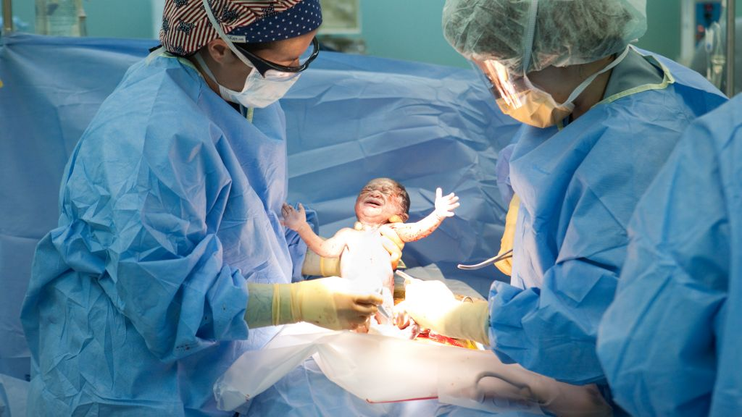
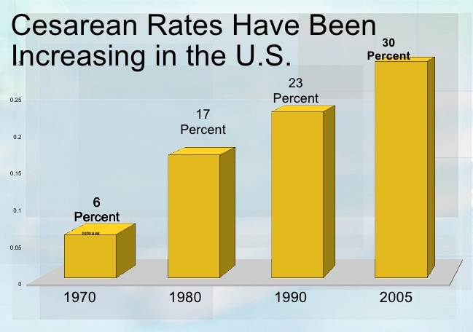
Samantha Martinez, MSN
Dr. Elizabeth Hartman, PhD, RN
Cesarean Births are More Profitable to Hopsitals and
Physicians Than Natural Births
Introduction:
Globally the United States spends the most on childbirth-related care at the rate of $86 billion annually, maternal-fetal outcomes have remained one of the worst in developed nations.The National Health Organization (NIH) reported an increase of 72 percent of c-sections from 1997-2008. According to the World Health Organization C-sections should be between 10-15%. Instead, the US has a rate of 32.2% in 2016.
Purpose: To increase awareness and educate the community on the way hospitals and physicians may benefit from cesarean sections.
Results & Discussion:
Fall in fertility rate, increase in the concentration of OBGYN physicians in an area, and recent malpractice suit and number of previous c-sections performed by physician all lead to increases in cesarean sections. Cesarean deliveries also increased on weekdays specifically Fridays as well as during the day between 6am-6pm in large and profitable hospitals.
2
1
Speculations in Rise of Cesarean section:
Technology detecting fetal distress (EFM)
Reports of fetal distress rose from 30% prior to 61% post
Risk of medical malpractice suits
“defensive medicine”
More efficient and less time consuimng for physicians
Fatigue, workload, aticipated sleep deprivation
Financial incentives
Dip in fertility
Less income
Increased amount of physicians
Supply and demand
Not willing to perform VBAC
Risks involved
Increase in health disparities
Obesity, HTN, CAD
Insurance
Nursing Implications:
Maternity mortiality is overall low, but compaired to vaginal birth, cesarean birth moretality rate is twice as high. Nurses are patient advocates and the safety and well being of a mother and newborn is a substantial part of a nurse’s job. Further updated research also needs to be conducted on the direct coorilation between hospital and physician incentives and cesarean sections taking health disparities into consideration.
Background:
The risk in cesarean rates, especially in primipara, between 1970-1991, speculated many questions behind the incentives. The most ruthless prediction is the financial incentive a trusted physician would benefit from. The workload and time consumption of vaginal delivery is higher than cesarean delivery. Since the average vaginal birth costs $32,093 and average cesarean costs $51,125, it is no surprise an incentive would be financial.
4
Conclusion:
There is no reliable way to put incentives into numbers; there are just predictions and the detection of trends. Although most studies show the correlation between an institution and physician incentive with the rise in cesarean sections, the evidence can be coincidental or have limitations that need to be further looked into. It also does not necessarily mean it was for financial benefit, other reasons such as time management could be the incentive.
5
Methods:
Literature reviewed was from the following databases: CINAHL Complete (1 articles used), ProQuest Nursing and Allied Health (1 article used), and PubMed (1 articles used). Search terms included: cesarean section and physician incenive plan.
Notes:
Picture 1: Thompson, M., Thompson, L., Reid-Chung, A., & Thompson, J. (2013). Managing traumatic brain injury: Appropriate assessment and a rationale for using neurofeedback and biofeedback to enhance recovery in post concussion syndrome. Biofeedback, 41(4), 158-173. http://doi:10.5298/1081-5937-41.4.07.
Picture 2: Seibert NeuroPsych, LLC. (2017). EEG results. Photos. Retrieved July 30, 2017 from https://www.yelp.com/biz/seibert-neuro-pysch-northeast-virginia-beach.
Picture 3: Thibault, R. T., Lifshitz, M., Birbaumer, N., & Raz, A. (2015). Neurofeedback, self-regulation, and brain imaging: Clinical science and fad in the service of mental disorders. Psychotherapy and Psychosomatics, 84(4), 193-207. http://dx.doi.org.ezproxy.depaul.edu/10.1159/000371714
Picture 4: Koberda, J. L. (2015) LORETA Z-score neurofeedback-effectiveness in rehabilitation of patients suffering from traumatic brain injury. J. Neurobiol 1(4): doi http://dx.doi.org.10.16966/23797150.113.
Picture 5: Sherlin, L. H., Arns, M, Lubar, J. Heinrich, H., Kerson, C., Strehl, Ul, & Sternman. M. B. (2011). Neurofeedback and basic learning theory: Implications for research and practice. Journal of Neurotherapy, 15, 292-304. http://doi: 10.1080/10874208.2011.623089.

