Slide 1
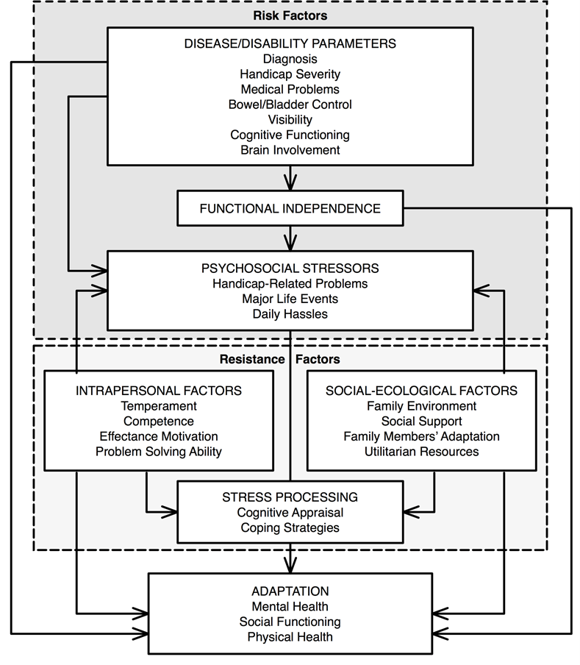
Complementary Art Interventions for Children Coping with Cancer:
An Integrative Literature Review
Brenda Pacheco
Research Advisor: Kim Amer, PhD, RN
Background & Significance
Methods
Results
The second leading cause of death for children ages 5-9 is cancer (CDC, 2016). Children are most commonly treated with conventional medicine. However, more families are considering alternative therapies to help children cope with cancer. Studies show that pediatric oncology patients have the highest use of complementary alternative medicine (CAM) (Post-White, Fitzgerald, Hageness, & Sencer, 2009).
The research was conducted in the form of an integrative review of literature design using Whittemore and Knafl’s methodology (2005).
After a thorough review of the literature and removal of duplicates, 258 studies were found. Seven studies were selected for inclusion. Of the 7 studies included in this review, 1 study focused on arts and crafts and 5 studies focused on music interventions. There was 1 study that included all three interventions (arts and crafts, music, and dance).
Conceptual Framework
Disease:
Cancer diagnosis
Problem and Purpose of Study
Treatment: Chemotherapy, stem cell transplant, radiation, side effects of treatment
Future Directions and Nursing Implications
A cancer diagnosis is a situational crisis that affects patients and their families (Docherty et al., 2013). An important role of the nurse is to provide holistic care to the patient as well as the family. Considering the popularity of CAM use in adult oncology patients, an integrative literature review on a subset of CAM; art interventions for children with cancer, would be very useful.
The aims of this integrative review were:
Determine if art interventions impact coping with cancer in a pediatric population.
Determine if the duration of the art intervention influences the impact on coping.
The role of a nurse is to provide holistic care to patients by considering all factors that contribute to stress and positive outcomes.
Evidence suggests a positive impact of the use of art interventions in coping with cancer in a pediatric population. Future studies need to include the duration of art interventions to further assess if there is an influence on benefits of coping with cancer. Conceptual model of risk and resistance factors would support ongoing research on coping in pediatric cancer patients (Wallander et al., 1989).
OUTCOMES OF ART INTERVENTIONS:
Arts & Crafts emotionally beneficial: form of self –expression, effective distractor
Music
Helped prevent distress, effective distractor, form of self-expression
Dance
Anxiety relief, effective distractor
Conclusion
Limitations
Findings suggest evidence of reduced anxiety, stress, and improved self-esteem amongst children with cancer who received various art interventions, however, there is a lack of evidence on the duration of art interventions and their impact. Further systematic studies should be conducted to explore the duration of art interventions that yield the most therapeutic results in stress coping in pediatric patients.
A limitation was the use of only 7 articles to complete this integrative literature review. Of the 7 articles found, only one article was used that included dance and only one that included the use of arts and crafts as an intervention.
Figure 1. Conceptual model of risk and resistance factors.
Conceptual model of risk and resistance (Figure 1) provides a better understanding of the different variables involved in a child’s coping with cancer. The factors that were identified in Wallander et al (1989) framework that pertain to cancer include disease, disability, psychosocial stressors, and resistance factors (Amer, 1999).
References
Amer, K. (1999). Children's adaptation to insulin dependent diabetes mellitus: A critical review of the literature. Pediatric Nursing, 25(6), 627-641. Retrieved from https://search.proquest.com/openview/7b5c5e3db21cf46dcaa536f6fa05767b/1?pq-origsite=gscholar&cbl=47659
Centers for Disease Control and Prevention. (2016). Ten leading causes of death and injury. Retrieved from https://www.cdc.gov/injury/wisqars/leadingcauses.html
Conceptual model of risk and resistance factors. Adapted from “Family resources as resistance factors for psychological maladjustment in chronically ill and handicapped children,” by J. L. Wallander, J. W. Varni, L. Babani, H.T. Banis, and K.T. Wilcox, 1989, Journal of Pediatric Psychology, 14, p. 171. Copyright 1989 by Plenum Publishing Corporation.
Wallander, J. L., Varni, J. W., Babani, L., Banis, H. T., & Wilcox, K. T. (1989). Family resources as resistance factors for psychological maladjustment in chronically ill and handicapped children. Journal of Pediatric Psychology, 14(2), 157-173. Retrieved from https://academic.oup.com/jpepsy/article-abstract/14/2/157/993500

