Slide 1
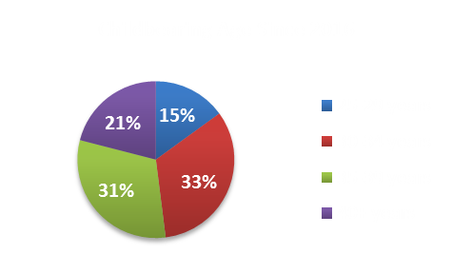
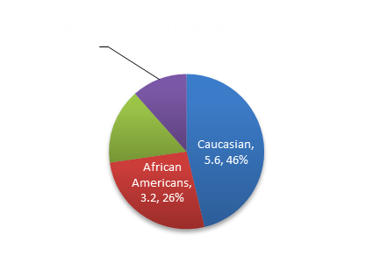
Challenges Associated with Advanced Maternal Age: An Integrated Review of the Literature
DePaul University School of Nursing
Krupa Patel, BS
Discussion
Background
Childbearing Trends
.
Advanced maternal age (AMA) is a growing social phenomenon. The proportion of first births to women ages 35 years and over in the United States have increased. Women are prolonging childbearing to accommodate their careers. Socioeconomic status, culture, and a movement towards a women making herself and career a priority has contributed to the increasing number of advanced maternal age births
Motive Behind Prolonging Childbearing
Career and lifestyle commitment was the most common reason women postponed childbearing.
Challenges
Financial challenges were minimal with AMA
Socially women felt a dynamic change
Physically women experienced more pronounced fatigue
Cultural Differences
Research did not identify why Caucasian women are more likely to prolong childbearing.
With many challenges and benefits that come with pregnancies, advanced maternal challenges are indefinite. Therefore, challenges associated with advanced maternal age remains unclear and current studies are limited, therefore future research is necessary to determine if the challenges and/or risks outweigh the benefits of having a child at an advanced maternal age.
Objectives/ Research Questions
The aim of this study was to gain a better understanding of the challenges associated with advanced maternal age pregnancies. This study looked into the challenges the mother faced at an older age, their reason behind prolonging childbearing, and cultural differences between these women.
Research Question(s)
Why do high socioeconomic women post-pone their first pregnancies to accommodate social lifestyle demands and careers? What complications and/or challenges do they face due to this decision?
What are the cultural differences behind women who choose to post-pone their first pregnancies?
Nursing Implications
Proportion of first births to women 35 years or older.
Nurse’s will often care for advanced maternal age patients, with sufficient knowledge of their care, nurses can educate patient’s regarding their fears and the challenges associated with this type of pregnancy.
Methods
Results
.
A detailed search was conducted using CINAHL, ProQuest, and PubMed. Primary sources reviewed were limited to articles over the last ten years.
Articles reviewed were of the nursing or medicine discipline. Articles reviewed involve a basis of challenges associated with advanced maternal age pregnancies.
A total of nine studies were selected for this study.
Non-Hispanic Caucasian women are more likely to prolong childbearing.
Women 35 years old and older experienced more pronounced fatigue during pregnancy than those who gave birth before 35 years old.
Older women were found to be more prepared financially to raise their children.
Older women were found to have more knowledge, be educated, make more money, and have better resources than their younger counterparts.
Future Research
Future Research should look into pregnancy trends and challenges women face in rural countries to identify the differences.

