Slide 1
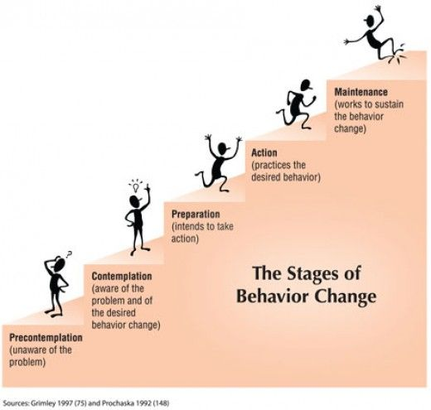
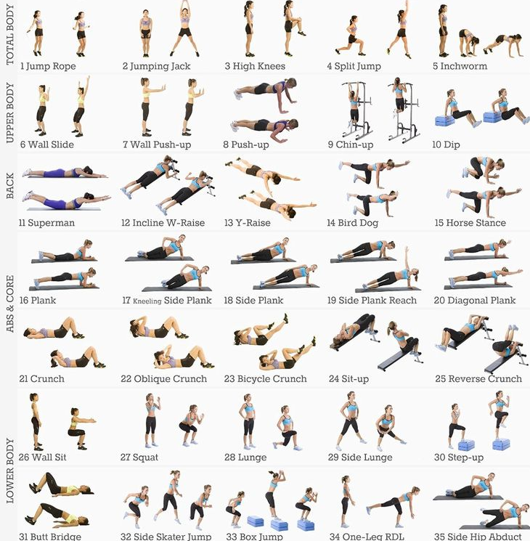
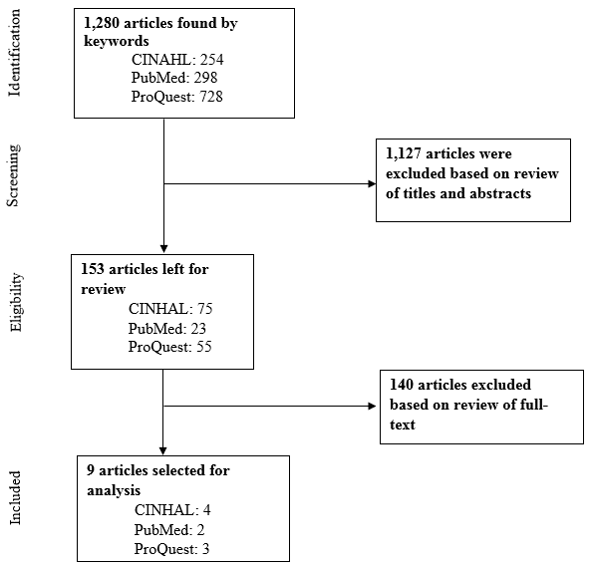
Development of Exercise Interventions for Healthy Adult Females with Overweight and Obesity: An Integrative Review
Hannah Lee, B.S.
School of Nursing
Background
Overweight and obesity rates have significantly increased in the adult female population^{.1} Decreased physical activity, sedentary lifestyles, and poor dietary choices have resulted in increased overweight and obesity prevalence in adult females.² These conditions also increase the risk for endometrial, ovarian, cervical, and breast cancers among this population.³
Conceptual Framework
With the overarching goal of adherence, management of overweight and obesity must take into consideration the many behavioral and lifestyle modifications that exercise interventions necessitate. It then becomes critical to identify the individual’s state of change.
Discussion
The incorporation of adherence factors, exercise intervention types, and risk factor modification creates a more holistic and comprehensive approach for the development of exercise programs and interventions for overweight and obese adult females.
Nursing
Implications
Advanced practice nurses can utilize these components in their clinical practice to enhance the effectiveness of their planning and implementation processes and optimize the health and wellness of this population.
Purpose
The purpose of this study was to determine components of exercise program development for healthy adult females with overweight and obesity through exploring these research questions:
1) What factors of adherence promote exercise training in healthy adult females with overweight and obesity?
2) Which exercise interventions have the greatest effect in modifying risk factors of overweight and obese adult females?
The transtheoretical model (TTM) is a health behavior theory that centers on distinct stages of change that define an individual’s readiness for behavior or lifestyle modification.
Methods
Using an integrative review, a search of the literature was conducted using the noted databases: Cumulative Index to Nursing Health Literature (CINAHL), ProQuest, and PubMed.
Keywords and multiple-word combinations include: obesity, overweight, female, women's health, exercise, adherence, weight loss, risk factors, health behaviors
Figure 2. This figure describes the transtheoretical model through its defined stages of change.
Results
Three principal concepts of exercise program development were determined and were evaluated based on research design and sample size to ensure rigor and validity.
Factors of Adherence | Type of Exercise Intervention | Risk Factor Modification
Social support | High-intensity interval training | Lipid profiles
Guided exercise programming | Aerobic training | Anthropometric parameters
Affective response | Resistance training | Cardiovascular health
Figure 3. Various exercises that can be utilized in high-intensity interval training.
Future Research
Future research should focus on cultivating a more sophisticated understanding of health perceptions, beliefs, values, and attitudes that overweight and obese women have towards exercise and physical activity to promote & facilitate increased exercise adherence and overall health and wellness.
Figure 1. This figure outlines the inclusion, exclusion, and selection process of the data selected for the integrative review.
Table 1. This table summarizes the key findings and pertinent concepts of the results section.
References: 1. Flegal, K. M., Kruszon-Moran, D., Carroll, M. D., Fryar, C. D., & Ogden, C. L. (2016). Trends in obesity among adults in the United States, 2005 to 2014. JAMA, 315(21), 2284-2294. doi:10.1001/jama.2016.6458 2. Duarte, C., Matos, M., Stubbs, R. J., Gale, C., Morris, L., Gouveia, J. P., … Gilbert, P. (2017). The impact of shame, self-critcism and social rank on eating behaviors in overweight and obese women participating in a weight managment program. PLoS ONE, 12(1), 167-571. doi:10.1371/journal. pone.0167571 3. Kulie, T. K., Slattengren, A., Redmer, J., Counts, H., Eglash, A., & Schrager, S. (2011). Obesity and women's health: An evidence-based Review. Journal of the American Board of Medicine, 24, 75-85. doi:10.3122/jabfm.2011.01.100076

