Slide 1
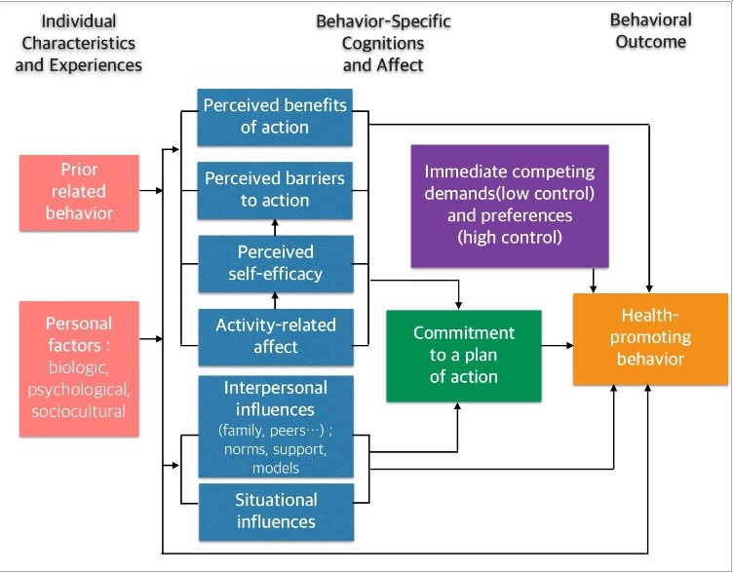
The Benefits of and Barriers to Psychiatric Advance
Directive Implementation Lauren A. Haindfield, B.S., MSN Candidate Faculty Advisor: Barbara Harris, PhD, RN
DePaul University
Background
Theoretical Framework
Discussion
Mental illness is one of the most prevalent healthcare topics that needs to be taken more seriously by the United States in its entirety (“Mental Health by the Numbers,” 2016).
1 in 5 (43.8 million) adults experience episodes of mental illness annually
1 in 25 (10 million) adults experience serious episodes of mental illness annually
Currently only 25 states in the U.S. endorse psychiatric advance directives
Mental health is a vital component of overall health without easily observed physical symptoms or tests, making an accurate diagnosis a crucial first step in treatment (“Know the Warning Signs,” 2016). Psychiatric advance directives (PADs) provide a way for individuals to take an active role in promoting mental health. A PAD is a legally binding document that outlines a patient’s decisions for future care (or refusal of care) in the event of a psychiatric crisis or that serves to appoint a surrogate decision maker to make those decisions (Nicaise et al., 2014).
This study was framed by Nola Pender’s Health Promotion Model which examined the processes behind motivating an individual to take an active role in improving overall health (Pender et al., 2011).
Examining behavior-specific cognitions and affect allowed the focus of PAD implementation to be shifted toward perceived benefits and barriers from both client and clinician standpoints.
This lead to the next step of the framework, commitment to a plan of acting, leading to the health-promoting behavior: PAD implementation.
Individuals with mental disorders expressed strong desires to have control over their future treatments and to receive assistance with drafting PADs to ensure they are honored by healthcare providers.
There lacks communication between specialties and also between facilities, leading to low PAD implementation.
Knowledge gaps by both patient and provider are hindering PAD use in current practices.
Nursing Implications
Purpose
Nurses can use the ”commitment to a plan” portion of the Health Promotion Model to tailor education materials for both patients and providers with the aim of increasing autonomy for the patient. Nurses play a crucial role in patient education, indicating how important their understanding of PADs is in order for patients to be adequately informed about this healthcare option. As patient advocates, nurses could be a crucial key to improving policy for patients with psychiatric disorders by serving as the intermediary between patient and provider.
The purpose of this study was to identify both the benefits of and barriers to PAD implementation in order to increase PAD use. This study identified stakeholder (consumer, healthcare provider, family member, ally) beliefs toward PAD in order to determine why there was limited PAD uptake.
Research Questions:
1.) What are the perceived benefits to psychiatric advance directive implementation?
2.) What are the perceived barriers to psychiatric advance directive implementation?
Conclusion
Methods
PADs are an under-utilized potentially integral part of mental healthcare in the ever changing climate of American healthcare. PADs show great promise in providing patients a sense of autonomy and control over their care in crisis situations. In order for PADs to gain traction, they must first be endorsed by all 50 states
PAD barriers must be addressed and solved with longevity studies on PAD implementation that take place for longer than one year. Patients with PAD must also have strong advocates within the healthcare system in order for PADs to be successful.
Mental health has become much less stigmatized over the past few years, making the potential for effective PAD implementation extremely promising in the near future.
This study was an integrative literature review of qualitative research on PAD implementation. This type of review allowed for evaluation of current evidence, synthesis of data, identification of research gaps, and proposed areas for future research (Whittemore & Knafl, 2005).
Databases used for this review included: CINAHL, PubMed, and PsychInfo.
Search terms: pad implementation, barriers to pad implementation, psychiatric advance directives, benefits of psychiatric advance directives, current pad practices
Results
Benefits:
Increased autonomy, empowerment, active participation in care
Appointment of a trusted surrogate decision-maker
Improved patient and provider therapeutic alliance
Feeling as though mental health needs were met
Barriers:
Knowledge gap amongst clients on how to prepare PADs
Knowledge gap amongst providers on PAD components
Disconnect between patient and provider view on PAD use
Missing easy way to access PAD documents in times of crisis
Fear by both patient and provider that client will be “too psychotic” to notify someone about a PAD
References
Know the warning signs (2016). National Alliance on Mental Illness. Retrieved from
http://www.nami.org/Learn-More/Know-the-Warning-Signs
Mental health by the numbers (2016). National Alliance on Mental Illness. Retrieved from
http://www.nami.org/Learn-More/Mental-Health-By-the-Numbers
Nicaise, P., Soto, V.E., Dubois, V., & Lorant, V. (2014). Users’ and health professionals’ values
in relation to a psychiatric intervention: The case of psychiatric advance directives.
Administration and Policy in Mental Health and Mental Health Services Research, 42,
384-393. doi:10.1007/s10488-014-0580-2
Pender, N.J., Murdaugh, C.L., & Parsons, M.A. (2011). Health promotion in nursing practice
(6th ed.). Upper Saddle River, NJ: Pearson.
Whittemore, R., & Knafl, K. (2005). The integrative review: Updated methodology. Journal of
Advanced Nursing 52(5), 546-553. doi: 10.1111/j.1365-2648.2005.03621.x

