Slide 1
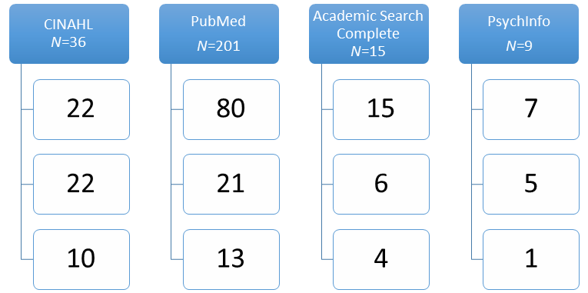
Postpartum Depression and Childbirth Education
An Integrative Literature Review
Marialicia J Kunkel
Background
Conclusions
Postpartum Depression (PPD) is a debilitating mood disorder that affects approximately 15% of women. ¹
Preventative methods are key to reducing prevalence of PPD.
Childbirth educators are in a unique position to disseminate information to new parents.
Findings indicated increased awareness of PPD increases the likelihood that individuals will seek help, thus reducing the prevalence of PPD.
More research is needed to establish a connection between childbirth education including postpartum depression and increasing awareness among new parents.
Purpose
Evaluate the current childbirth education curriculum
Establish if parents are educated in PPD prior to giving birth and if that raises awareness.
10
Nursing Implications
Results
Nurses are often childbirth educators, and therefore must be aware of the importance of including PPD into the curriculum.
Nurse Midwives should include PPD education in their prenatal care to help reduce the prevalence.
The following themes were found to be relevant throughout the ten articles:
Timing of PPD education: Education of parents by healthcare providers, childbirth educators proved to me more effective prior to giving birth. Education during hospital stay did not prove to be effective on reducing prevalence of PPD.
Health Information Levels: Women who were educated prior to giving birth on prenatal information, the labor process, and care for the new infant all showed significant reduction in EDPS scores. Women who had a centralized health locus of controlled also showed a reduction in PPD symptoms.
Awareness of Signs and Risk Factors: Literature showed that by educating new mothers of potential risk factors and signs of PPD prior to birth, they were able to seek help quickly if experiencing these symptoms.
Childbirth Experience: Educating mothers on what they can experience during childbirth was effective in reducing PPD score.
Research Question
How can education of new parents help raise awareness of postpartum depression?
Materials & Methods
Databases used: Cumulative Index of Nursing and Allied Health (CINAHL) Complete, Academic Search Complete, PubMed, and PsychInfo.
Search terms: postpartum, depression, education, doulas childbirth and awareness
Theoretical Framework: Biopsychosocial Model by George L. Engel. ²
References
Brummelte, S., & Galea, L. A. (2016). Postpartum depression: Etiology, treatment and consequences for maternal care. Hormones and Behavior, 77, 153-166. doi:10.1016/j.yhbeh.2015.08.008
Suls, J., & Rothman, A. (2004). Evolution of the Biopsychosocial Model: Prospects and Challenges for Health Psychology. Health Psychology, 23(2), 119-125. doi:10.1037/0278-6133.23.2.119

